Slide 1
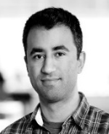
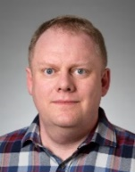
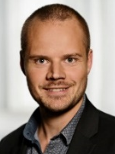
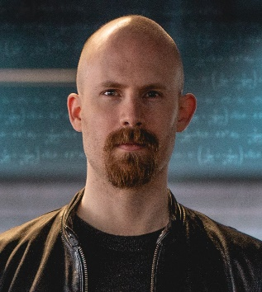
Peyman Afshani associate professor Computational geometry External memory algorithms
Gerth Stølting Brodal professor Data structures External memory algorithms
Kasper Green Larsen associate professor Data structures Lower bounds
Chris Schwiegelshohn assistant professor Machine learning Dimension reduction
Bachelor projects in Algorithms
A typical BSc project (and MSc thesis) consists of
reading and understanding in depth one or more research papers
getting an overview of related results in the literature
implementing one or more algorithms / data structures
experimental evaluation of the implementation
writing a report summarizing all the above, incl. rephrasing central theory
Depending on ambition of the project group and the progress during semester
technical complexity of algorithms considered
balance between theory / implementation / experimental evaluation
confirm known experiments / first implementation / novel research
project description adjusted based on progress
Courses | BSc | Algorithms and Data Structures (CS, 1st semester, Brodal) Computer Architecture, Networks and Operating Systems (CS & IT 4th semester, Afshani) Machine Learning (CS, 5th semester, Larsen) Introduction to Programming with Scientific Applications (non-CS, Brodal)
 | MSc | Computational Geometry: Theory and Experimentation (CS, 1st semester, Afshani / Arge) Randomized Algorithms (CS, 2nd semester, Larsen) Cluster Analysis (CS, 2nd semester, Schwiegelshohn)

